Slide 1
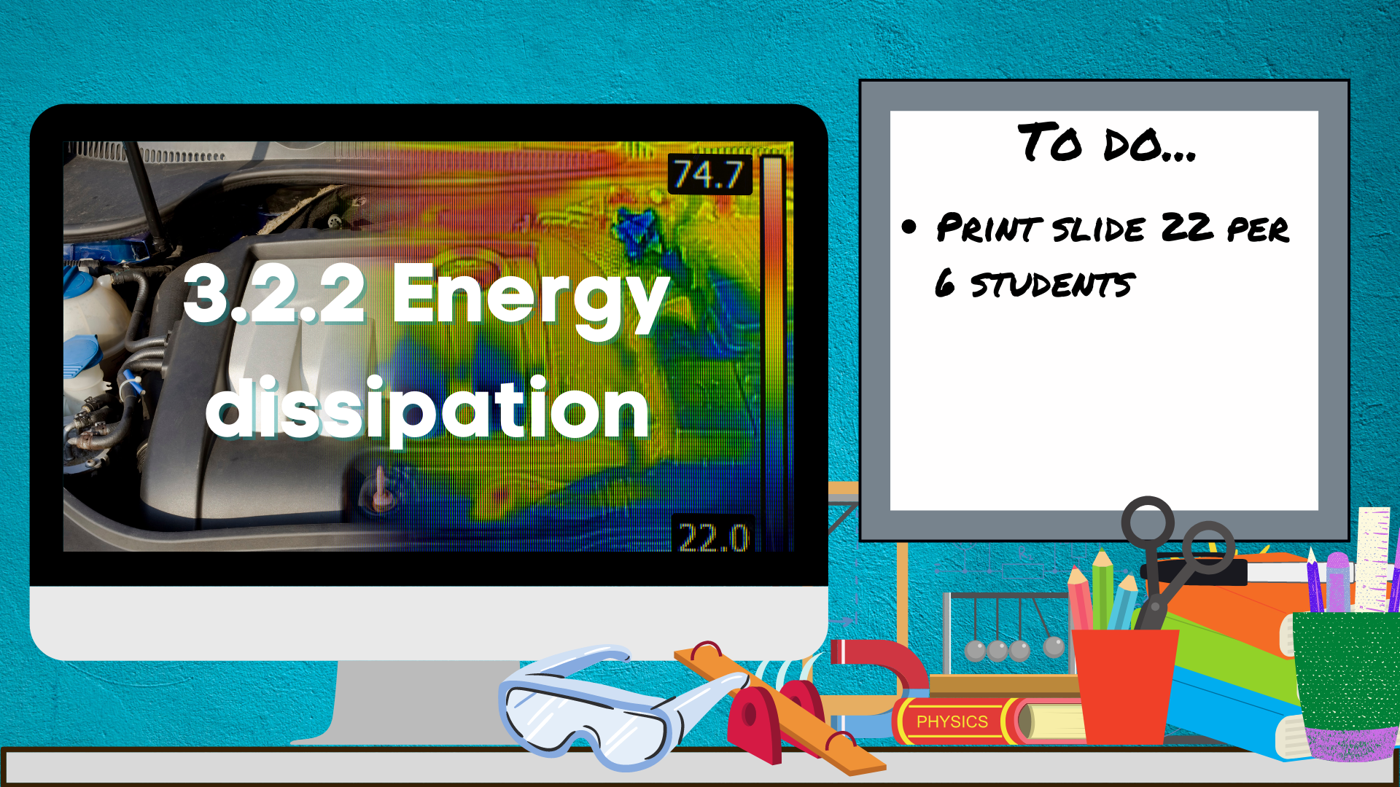
Print slide 22 per 6 students

Slide 2


Behaviour targets:
Remain silent when the teacher is talking.
Stay on task throughout the lesson.
Speak to staff and other students in a polite way.
Refrain from unnecessary contact with others.

Slide 3

DO THIS NOW…
Either
Define 3 keywords from last lesson
Or
Write down 3 key points from last lesson in summary sentence form (bullet points)
Or
Summarise the learning of last lesson into a paragraph using full sentences.

Slide 4
Energy dissipation
3 July 2021
Learning Objectives
Understand how energy is transferred usefully or is ‘wasted’
Success Criteria –
K- state what dissipation means. do simple calculations of wasted energy from input and useful energies. state what lubrication and streamlining mean.
A- explain how energy is dissipated in a range of situations. calculate useful energy and wasted energy from input and output energies. describe how dissipated energy can be reduced.
E- account for all energy transfers in a range of situations. calculate a useful and wasted energy, and efficiency. evaluate methods of reducing energy dissipation.
Key terms- dissipation
Equipment out, date and title underlined, key terms written down

Slide 5

Think, pair, share…
What does it mean to ‘save’ energy’?
If energy is conserved, how can it be saved?
Did you know… when plugged in but not in use, computers, printers, mobile phone chargers, and other electronics still draw energy and can account for 10% of a home energy bill each month.

Slide 6

New information- Wasting energy
The useful energy is in a kinetic energy store, and the wasted energy is in the thermal energy store
When I’m driving into work in the morning my car burns fuel to release energy from the chemical energy store.
Which store of energy do I not want this energy transferred into? Why?
Which store of energy do I want this energy transferred into?
Chemical energy store
Thermal energy store
Kinetic energy store
GPE energy store
Elastic energy store

Slide 7
New information- Wasting energy
When I’m driving, energy is transferred to the thermal store of the surroundings.
The air or ground heats up a bit. That is not useful.
You cannot transfer that energy to another store, so it is effectively ‘wasted’. Scientists say that the energy is dissipated.

Slide 8

Demonstrate understanding
Task: Explain what the term ‘dissipation’ means.
Dissipation is the transfer of energy to a store, usually the thermal store of the surroundings, so that it is no longer useful.
2 minutes

Slide 9
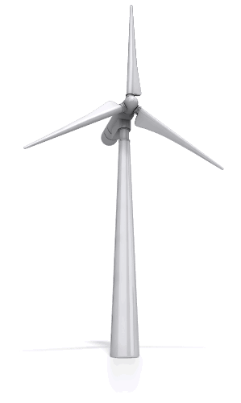
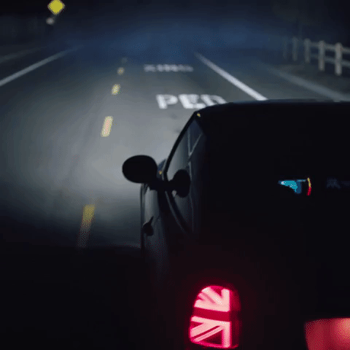
Challenge activity- Useful or wasted?
Task: For each of the the following devices, identify the useful energy transfer(s) and the wasted energy transfer(s) (outputs only)
Chemical energy store
Thermal energy store
Kinetic energy store
GPE energy store
Elastic energy store

Slide 10
Think, pair, share…
End
1
2
3
4
5
6
7
8
9
10
11
12
13
14
15
16
17
18
19
20
21
22
23
24
25
26
27
28
29
30
31
32
33
34
35
36
37
38
39
40
41
42
43
44
45
46
47
48
49
50
51
52
53
54
55
56
57
58
59
60
Why is energy dissipated?
Can you reduce / stop it?

Slide 11
New information- Energy dissipation
In a car, energy is transferred (wasted) to the thermal energy store because of the contact forces acting on the car.
Air resistance
Friction between engine parts
Friction
How could you reduce dissipation in a car?

Slide 12
New information- Energy dissipation
Energy is not just dissipated by contact forces.
Friction between surfaces can make them vibrate, producing sound.
When objects get hot, they transfer energy to anything around them that is at a lower temperature. You can reduce dissipation by using insulation.
When a current flows through a wire, the wire gets hot. This transfers energy to the thermal energy store of the surroundings. You can reduce the energy dissipated by reducing the resistance of the wires.

Slide 13
Demonstrate understanding
Task: Suggest two ways of reducing energy dissipation.
You can reduce energy dissipation by (any two from) reducing air resistance by streamlining / reducing friction in the engine by lubrication / reducing resistance of wires and using insulation.
2 minutes

Slide 14

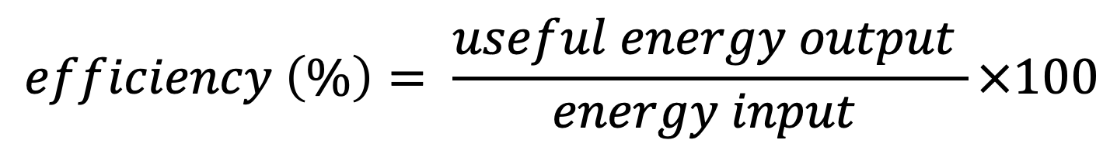
New information- Efficiency
You can show how much energy is transferred usefully, and how much is wasted, using the idea of efficiency.
$$efficiency \left(\%\right)= \frac{useful energy output }{energy input }×100$$
Worked example:
If the energy transferred from the chemical energy store of the fuel and oxygen in a car is 100J and only 40J is transferred to the kinetic energy store, then the engine is 40% efficient.
The wasted energy, or energy dissipated
= energy input – useful energy output
= 100J – 40J
= 60J

Slide 15

Challenge activity- Investigating the efficiency of light bulbs
Calculate the wasted energy for each bulb. Fill in the table with your answers.
State the formula for efficiency.
Use the formula for efficiency to calculate the percentage efficiency of each bulb. Fill in the table with your answers and rank them from 1 to 4 in terms of efficiency.
Describe what is meant by efficiency.
Suggest reasons why some bulbs are more efficient than others. Use this answer and your answer to Question 4 to explain why you cannot have a bulb that is 100% efficient.
A large percentage of the electricity we use is for lighting our homes. Different types of lightbulb are useful for different purposes and in different places in the house.
This table provides data for some different light bulbs. You will use this data to answer the questions that follow.
Light bulb type | Input energy in joules | Useful output energy in joules | Wasted energy in joules | Percentage efficiency | Rank
filament | 3600 | 108
CFL | 300 | 39
filament | 1500 | 60
CFL | 900 | 99

Slide 16
Demonstrate understanding
A kettle transfers 200 J of energy to the thermal energy store of the water in it for every 500 J of input energy. Calculate the wasted energy. Show your working
Calculate the efficiency of the kettle. Show your working.
Wasted energy = 500 J – 200 J = 300 J
Efficiency = useful energy ÷ total energy x 100
200 J ÷ 500 J x 100 = 40%
5 minutes

Slide 17
Think, pair, share…
Why do I save you money compared to Him?
Less electrical energy is needed by him to produce the same amount of light as me. He doesn’t waste as much energy as heat.

Slide 18
New information- Wasting energy
You may have heard people say it is important to save energy.
But if energy is conserved, how can you save it?
You aren’t really saving energy. You are saving fuel. There is less wasted energy, so you need to use less fuel to do the job that you want.

Slide 19
Demonstrate understanding
Conservation of energy says energy cannot be created or destroyed, just transferred from one store to another. Energy is dissipated when energy is transferred to a store so that it is no longer useful or it spreads out. All processes dissipate energy (usually to a thermal store of the surroundings).
In any process there is a useful energy transfer, and a wasted energy transfer (dissipation). You can calculate the energy dissipated if you know the useful energy transferred and the total energy transferred (energy dissipated = total energy transferred – useful energy transferred).
Task: Compare the conservation of energy and the dissipation of energy, and explain the link between the two.
5 minutes

Slide 20


Review and reflect
Which outcome did you reach? What skills do you do well?
What could you do to progress even further/ reach the next outcome?
K- state what dissipation means. do simple calculations of wasted energy from input and useful energies. state what lubrication and streamlining mean.
A- explain how energy is dissipated in a range of situations. calculate useful energy and wasted energy from input and output energies. describe how dissipated energy can be reduced.
E- account for all energy transfers in a range of situations. calculate a useful and wasted energy, and efficiency. evaluate methods of reducing energy dissipation

Slide 21
For printing……

